Slide 1
Yield Prediction On Corn Fields
Team Registration Id
AIH19T-0001_AI03
.

Slide 2
TEAM

Slide 3

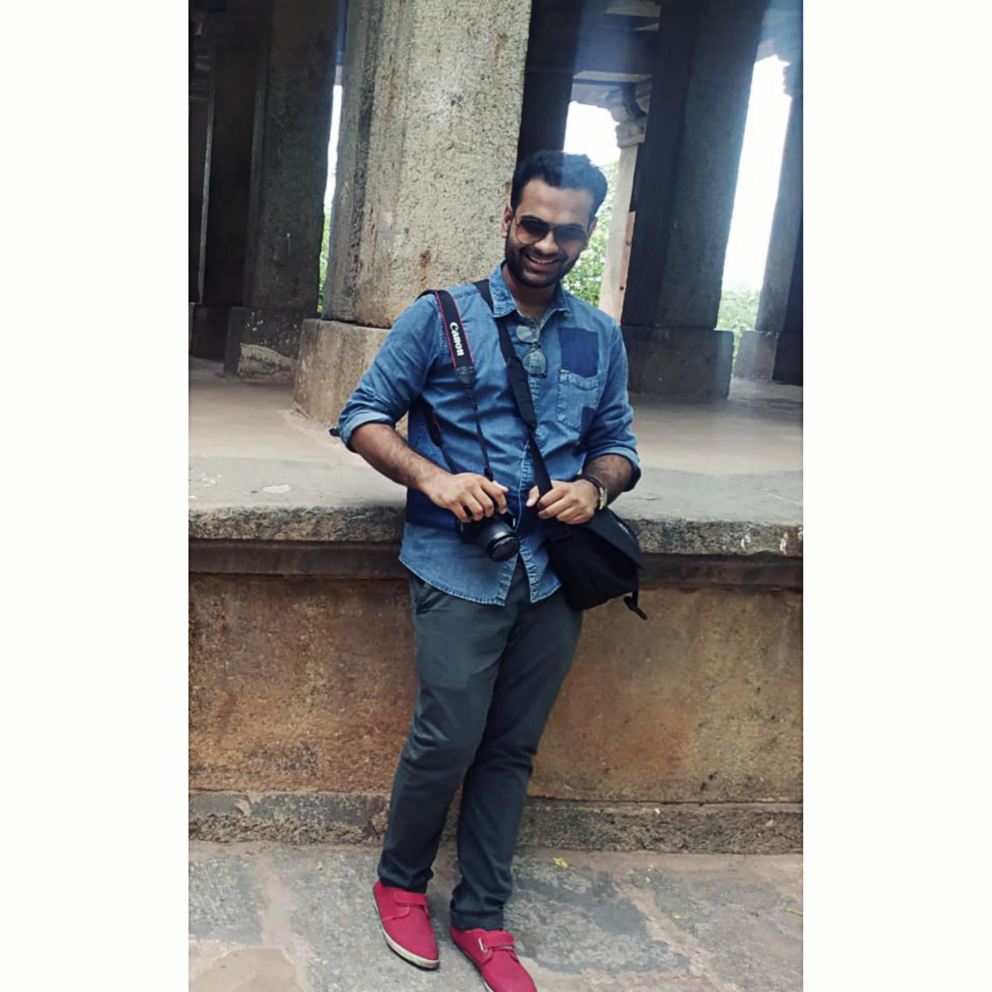
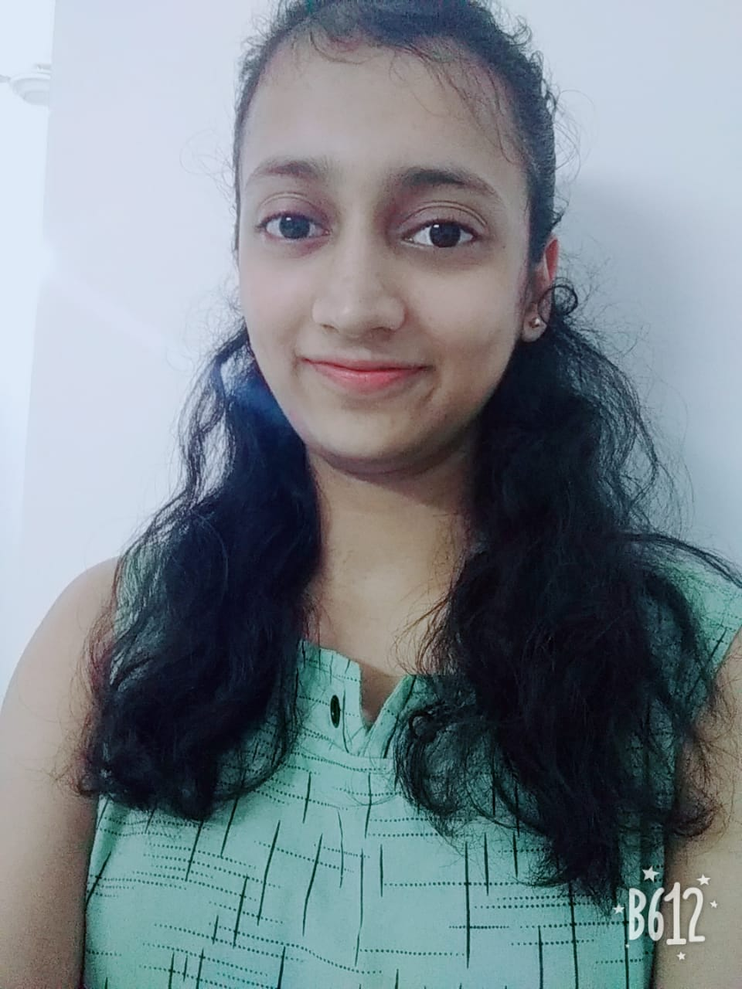
Kinshuk Gupta
kinshukg31@gmail.com
Bennett University
Image processing
“I back propagate”
Pradyumn Jain
pradyumn25jain@gmail.com
Bennett university
Data analytics
“I read between the parentheses”
Ruchira Gahlaut
ruchiragahlaut@gmail.com
Bennett University
Advanced python
“I fill colors into code”

Slide 4

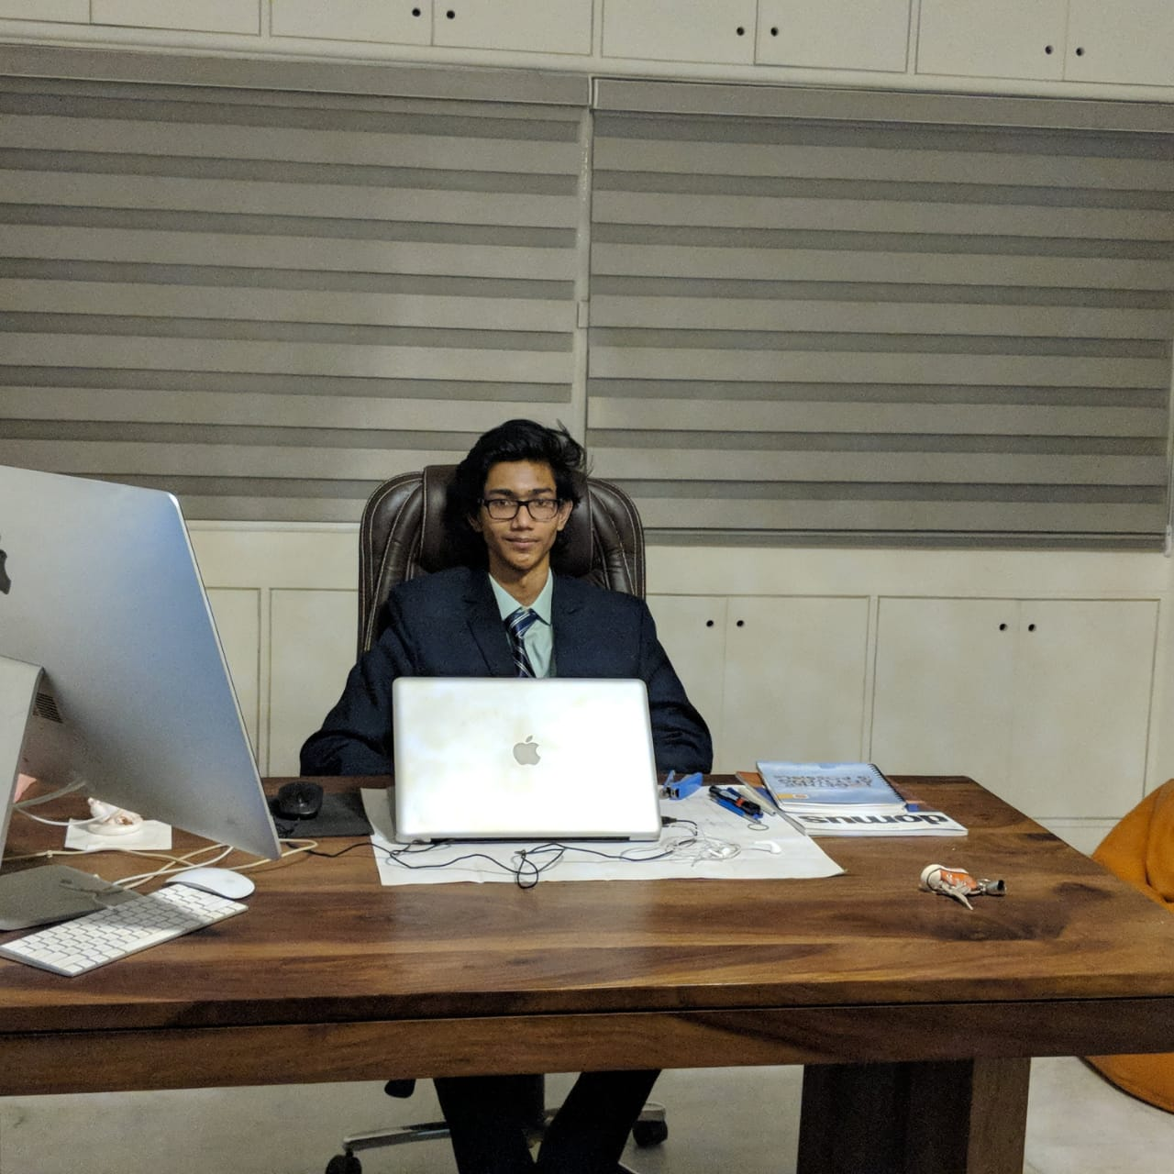
Himanshu Mittal
greathimanshumittal@gmail.com
Bennett University
Machine learning
“Me and my machine are perpetually learning.”
Aniket Biprojit Chowdhury
8.aniket.chowdhury@gmail.com
Bennett university
Computer vision
“I enjoy the colors of life through RGB matrices.”

Slide 5
PROBLEM STATEMENT
Our mission is to help the farmers to keep track of the corn plant yield and maximise the production of the corn plant. We have to keep track of the density of the crop throughout the land.
Doing so will inform the farmers of the areas where yield is not satisfactory so that suitable action can be taken by the farmer on that area for better production.
We have to provide the farmer with all essential information to maximize his yield. Our idea is to use computer-vision to accurately collect insights of crop germination and density of germinated plants.
This project simplifies the farmer’s work to directly walk up to to the required crops to take further action and skip the hectic process of manual pre-analysis.

Slide 6
THE INDIAN SCENARIO

Slide 7
FINANCIAL PERSPECTIVE
Predicting the crop yield can be extremely useful for farmers. If they have an idea of the amount of yield they can expect, they can contract their crop prior to harvest, often securing a more competitive price than if they were to wait until after harvest.
01
02
As per 2018, agriculture employed 50% of the Indian work force and contributed 17-18% to country's GDP. Our solution can improve the financial situation of this huge community and help solving the farming crisis.
03
As per a research conducted by CSDS in 2018, around 76% of the farmers wanted to leave farming and there were more than 8,000 suicides(2016) due to financial pressure. Thus, there is an urgent need to solve this crisis as a large part of our country depends on farming.

Slide 8
ENVIRONMENTAL PERSPECTIVE
01
Farmers would be able to look for long term sustainability and prioritize caring for the soil, because they can recognise that the healthy soil is promoting healthy crops .
02
The proposed solution will limit the high reliance on chemical fertilizers, thus help save the agro ecosystem functioning which is being disconnected from the internal cycling of key plant nutrients.

Slide 9
PROPOSED SOLUTIONS

Slide 10
PROPOSED SOLUTIONS
NDVI and edge detection based computationally efficient model pipeline .
2. Fast converging deep learning architectures for object classification .
3. Analysis of NDVI and edge detection pipeline with the deep learning architecture based on the error function.

Slide 11
APPROACH 1

Slide 12
PROCESS
CALCULATE NDVI
EDGE DETECTION
CHOOSING KERNEL SIZE
APPLY CONVOLUTION
GENERATE SHAPE FILE

Slide 13
BRIEF
In the following approach we will calculate the NDVI and apply image processing techniques ,based on the difference between the background (soil) and crops which is very distinct.
This is our fastest approach because it does not rely on neural networks for prediction and gives good accuracy.

Slide 14
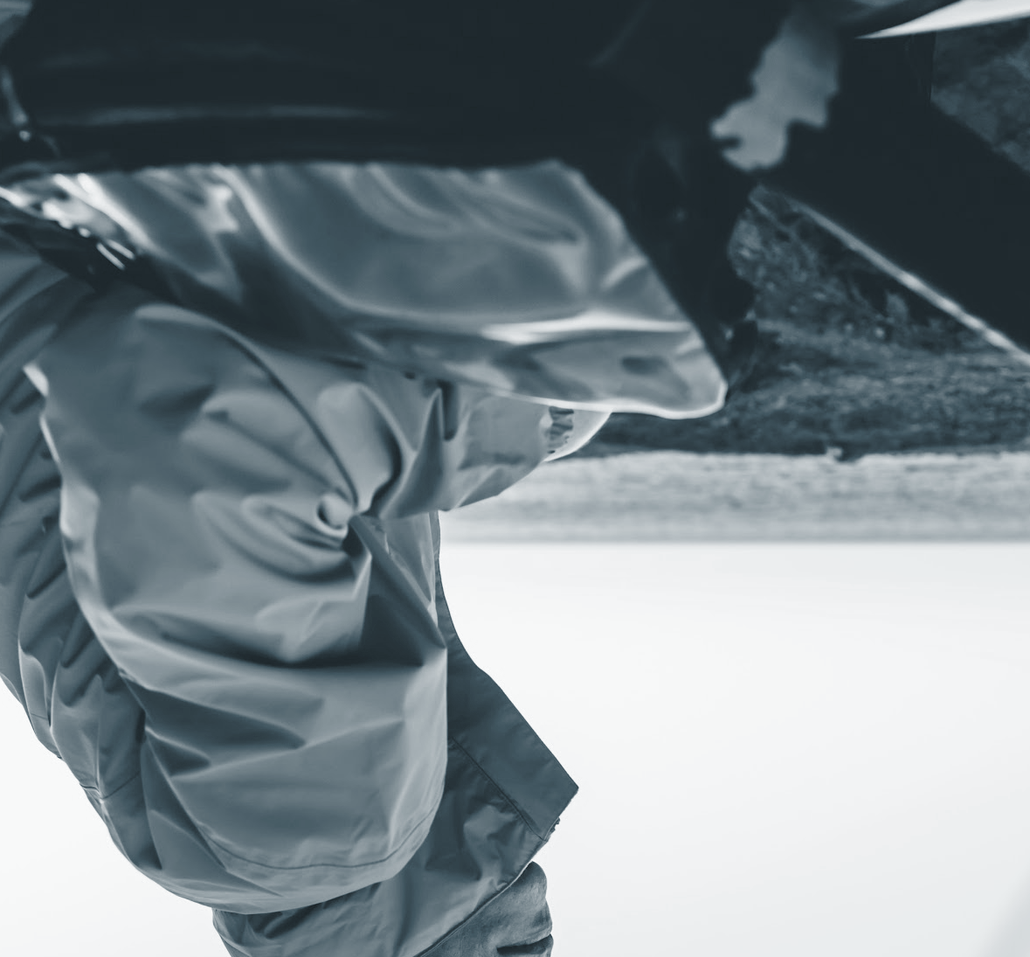
What is NDVI?
Normalized Difference Vegetation Index (NDVI) quantifies vegetation by measuring the difference between near-infrared (which vegetation strongly reflects) and red light (which vegetation absorbs).
NDVI always ranges from -1 to +1. But there isn’t a distinct boundary for each type of land cover.
For example, when you have negative values, it’s highly likely that it’s water. On the other hand, if you have a NDVI value close to +1, there’s a high possibility that it’s dense green leaves. But when NDVI is close to zero, there isn’t green leaves.

Slide 15
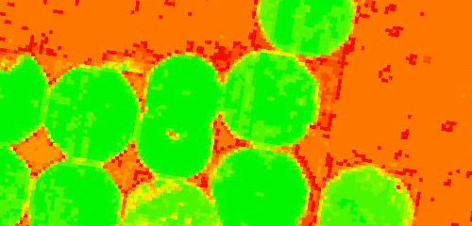
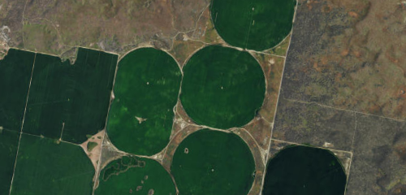
1. Calculating NDVI
Our first step is to calculate NDVI of the input aerial image that will be produced by drone.
This will provide us NDVI mask which separates soil and crop.
OUTPUT
INPUT

Slide 16
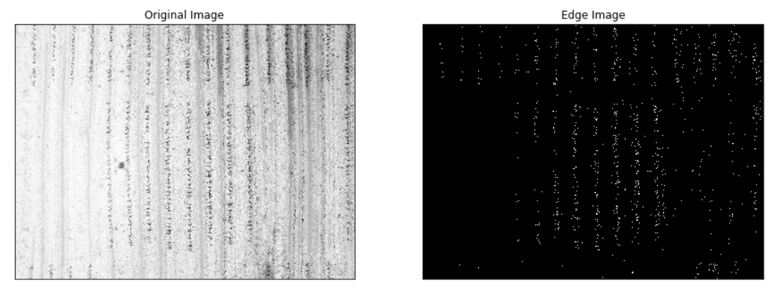
2. Edge detection
After we received the NDVI mask, we can apply circular edge detection or threshold instance segmentation to separate out individual crop and assign all pixel values a binary value 0 or 1 depending on whether pixel is part of soil or crop.
This way we can easily count the number of crops in the image. This can be used to gain some important information like average distance between two crop and even visualise the growth of the plant if aerial images are generated each day by drone.
Algorithms for edge detection that we may use are sobel method, canny method and laplacian of gaussian edge detection.

Slide 17
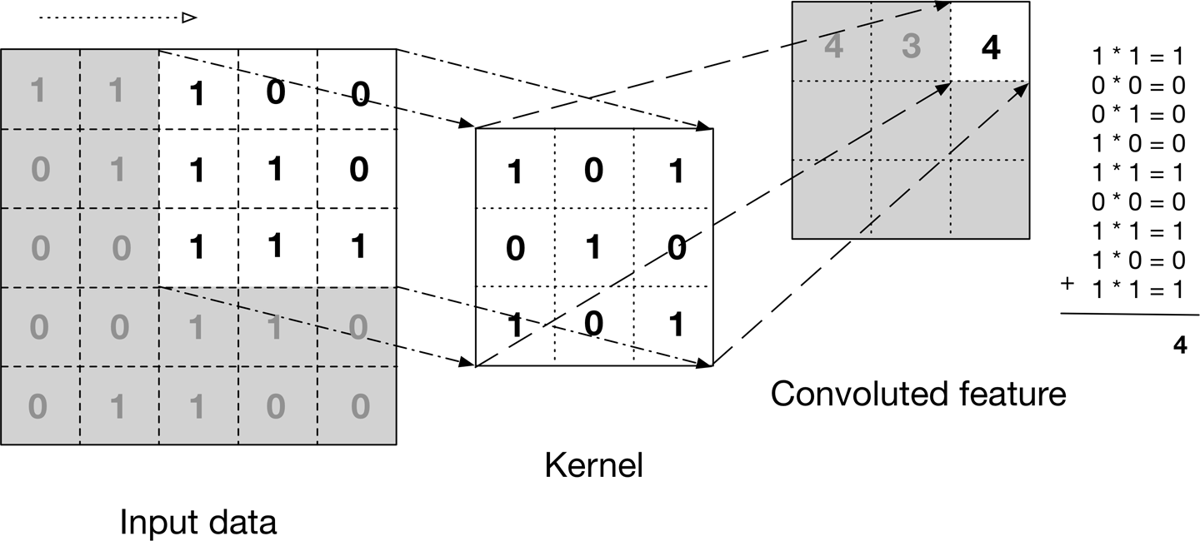
3. Choose kernel/filter size
Choose a kernel size depending upon the distance between two consecutive rows and columns of crops. Stride size will be assigned as per the depth of density required.

Slide 18
4. Apply convolution
After choosing the desired kernel, we apply convolution to our processed image so far along with some image processing algorithms.
Image processing is also crucial step to give good approximations near the boundaries.
Depth required for density calculation will be calculated depending on the parameters like distance, and resolution.
This will output the density map/mask for the image.

Slide 19
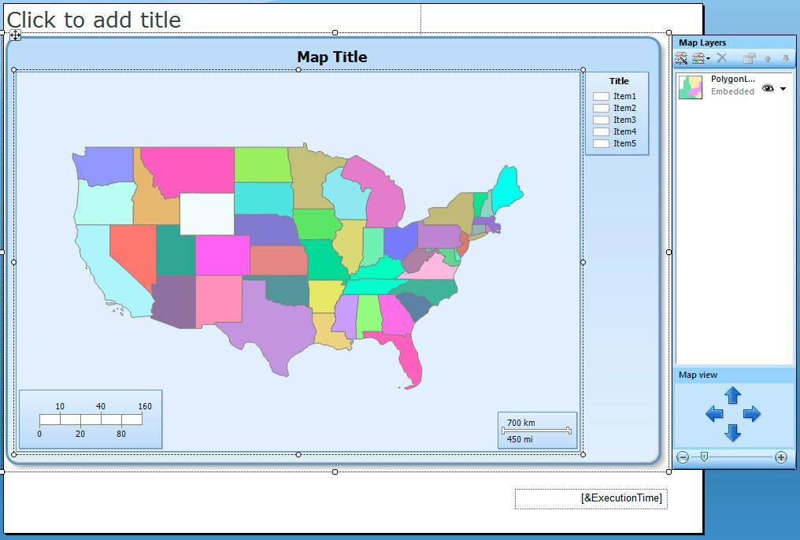
5. Generating shape file
A shape file is a simple , non topological format for storing the geometric location and attribute information of geographic features. Geographic features in a shapefile can be represented by points,lines, or polygons(area).
After that, we can make application to display suitable information to farmers in easily readable format.

Slide 20
APPROACH 2

Slide 21
PROCESS
AUGMENT INPUT LAYER
TRAINING
DENSITY MAP
GENERATE SHAPE FILE

Slide 22
BRIEF
This method uses deep neural networks for object detection. It is computationally expensive to train as well as classify but it is expected to achieve better accuracy than our first method.
There is a trade-off between performance and precision.

Slide 23
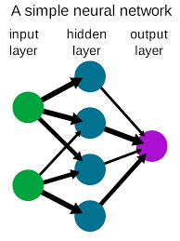
What are neural networks?
Neurals Networks are non linear statistical data modeling or decision making tools.They can be used to model complex relationship between inputs and outputs or to find patterns in data.
There are three layers in neural network :
Input layer : they provides information from the outside world , no
computation performed in any input nodes .
Hidden layer : they perform computations and transfer
information from input nodes to output nodes .
Output layer : they are responsible for computations and
transferring information from network to outside world .

Slide 24
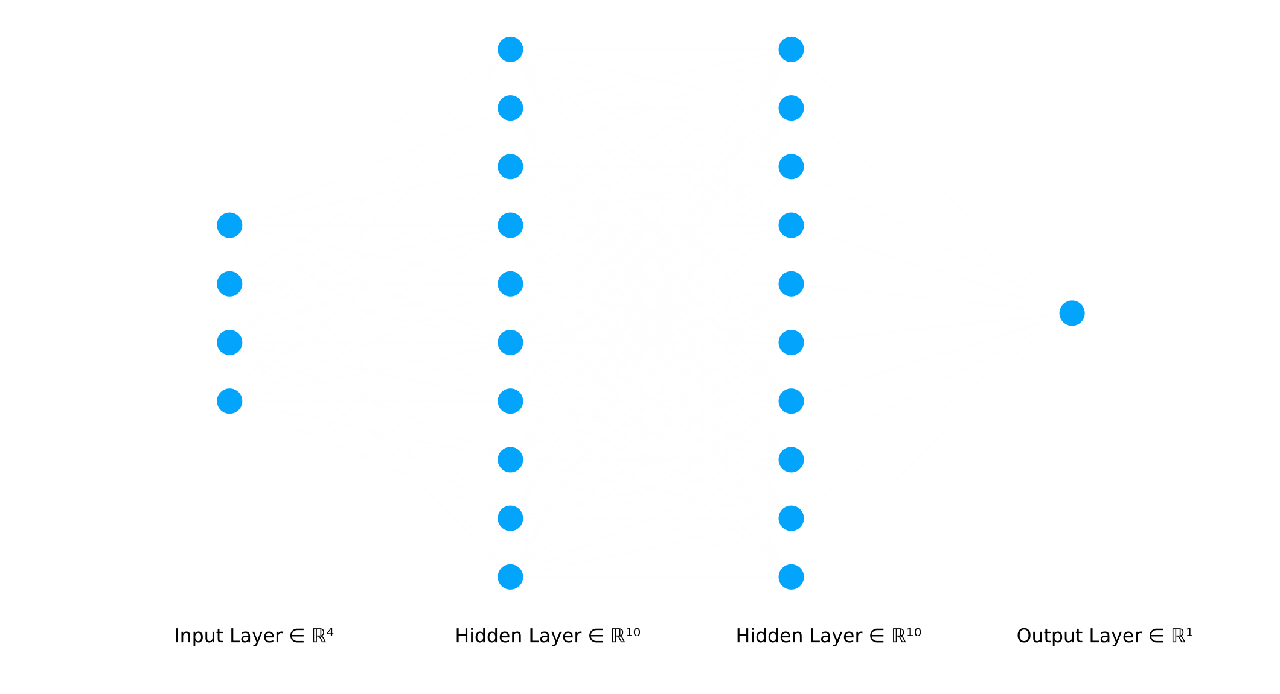
1. Augment input layer for faster convergence
In addition to RGB and NIR bands coming from our input image, we will add NDVI and edge detection mask also as additional features to input layer.
Input layer will consist of:
RGB Band (from original dataset)
NIR Band (from original dataset)
NDVI mask (pre-processed)
Edge mask (pre-processed)
By doing this, we reduce the time taken to extract features or patterns from the image so it can fine tune the weights faster.

Slide 25
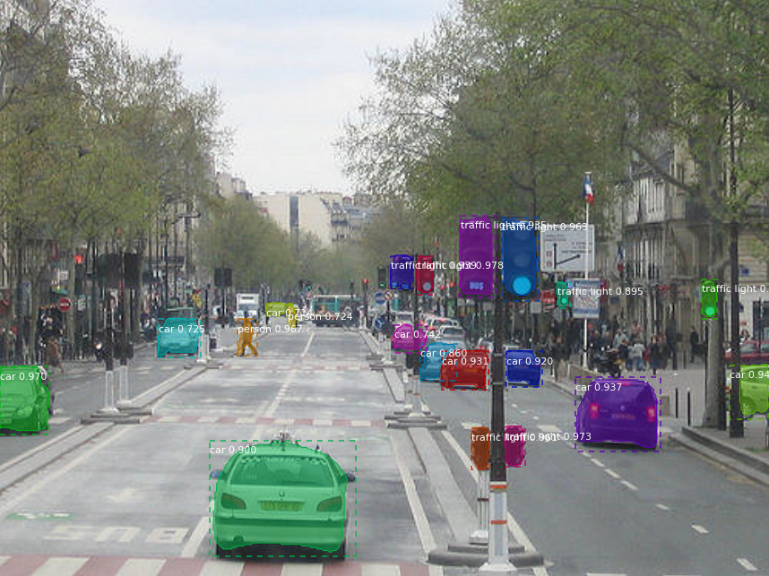
2. Training
Train on the annotated dataset using pre trained model like mask RCNN, RefineDet and state of the art ResNeXt variations or we can create our own model using ResNet as a generator model and a discriminator model to build a Generative Adversarial Network.
Note: Models can be one shot object detection or two step approach object detection depending on the latency required.
Source: https://github.com/matterport/Mask_RCNN

Slide 26
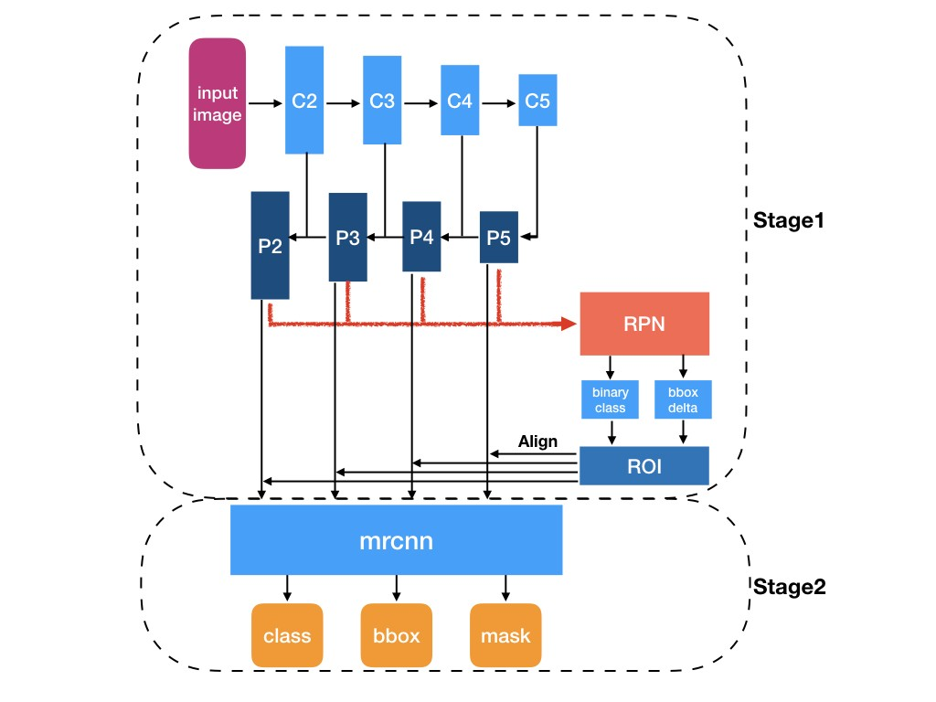
Mask R-CNN ARCHITECTURE
https://arxiv.org/pdf/1703.06870.pdf

Slide 27
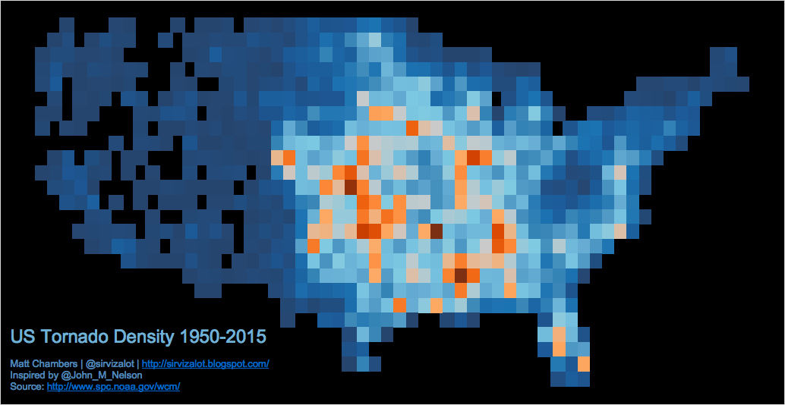
3. Create density heatmap
Deduce down the results from the output and create density heatmap for crop field.
Basically we have reached the conclusion. Analyze the results, fine tune and retrain to achieve as good accuracy as possible.
Density map is a matrix of values for particular area which tells the intensity of the feature we are interested in that area. Here, warmer the color more the chances of tornado occurrence.

Slide 28
APPROACH 3

Slide 29
PROCESS
GET EDGE DETECTION MASK FROM APPROACH 1
GET EDGE DETECTION MASK FROM APPROACH 2
MERGE THE RESULTS
GENERATE SHAPE FILE

Slide 30
BRIEF
This approach is to minimise the gap between the ground truth and the predicted output. It is achieved by combining the results from previous approaches .

Slide 31
Process
After getting edge detection mask from both approaches 1 and 2, we can merge them according to the predicted number of crops we are away from ground truth.
Results from approach 1 | Results from approach 2 | Merge rule
More number of crops than ground truth | More number of crops than ground truth | Only those pixels in which both pixel is marked crop
Less number of crops than ground truth | Less number of crops than ground truth | Only those pixels in which either pixel is marked crop
More number of crops than ground truth | Less number of crops than ground truth | Depends on the magnitude of error function

Slide 32
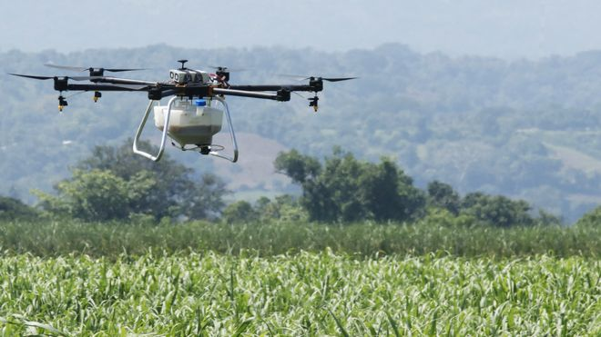
Viability
All the approaches are simple to execute as long as the crop fields can be monitored.
Our solution is easy-to-deploy and maintain.
The model will be updated according to confusion matrix which would increase accuracy.
The model is quick and efficient.

Slide 33
THANK YOU

